Slide 1
National Power Grid
&
High Tension Transmission
Michael Adeleye, Ph.D, P.G. Dip.Ed.

Slide 2


To understand how electricity is distributed in the UK (and Nigeria having inherited the British system) via the National Grid
To understand how transformers are used to minimise energy losses due to heat during electricity transmission

Slide 3

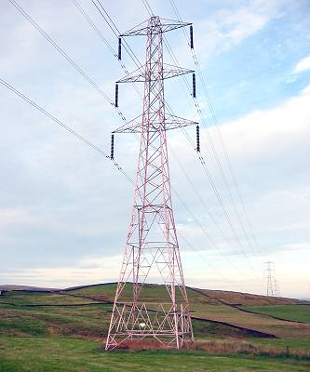
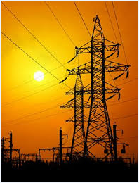
The National grid is a network of cables (underground and on pylons) and transformers used to transfer electricity from power stations to consumers all over the country.
Power stations generate electricity at 25 kV and at 50Hz

Slide 4

An electric power cable in the National grid consists of six aluminium (or copper) wires c surrounding a steel core s.
The steel core provides reinforcement – mechanical strength.

Slide 5

Each power station may well produce in the order of 50-100 MW of electrical power
When high currents flow through wires, there is a heating effect (I²R).
To achieve a given power distribution, there is a choice of voltage and current (P=VI).
To reduce the energy lost due to the heating effect of the current through the cables, the electricity is distributed at a higher voltage and lower current – High Tension power transmission
Notes:
When an electrical power is transmitted along a metal wire, it gradually loses power, mostly as thermal energy in heating the wire.

Slide 6

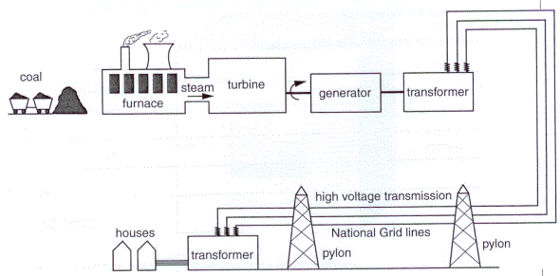
In particular step-up transformers are used between the power station and the grid to achieve a transmission voltage of 275-400kV

Slide 7

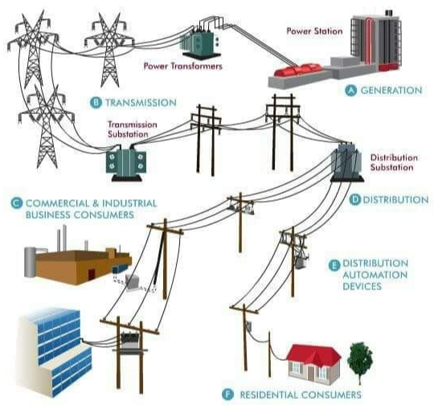

Slide 8

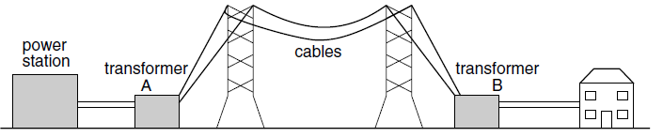
Power Station : 25kV
National grid : 250-400kV
Industry 11-33kV (Three phase)
Homes 230V (Single Phase)

Slide 9

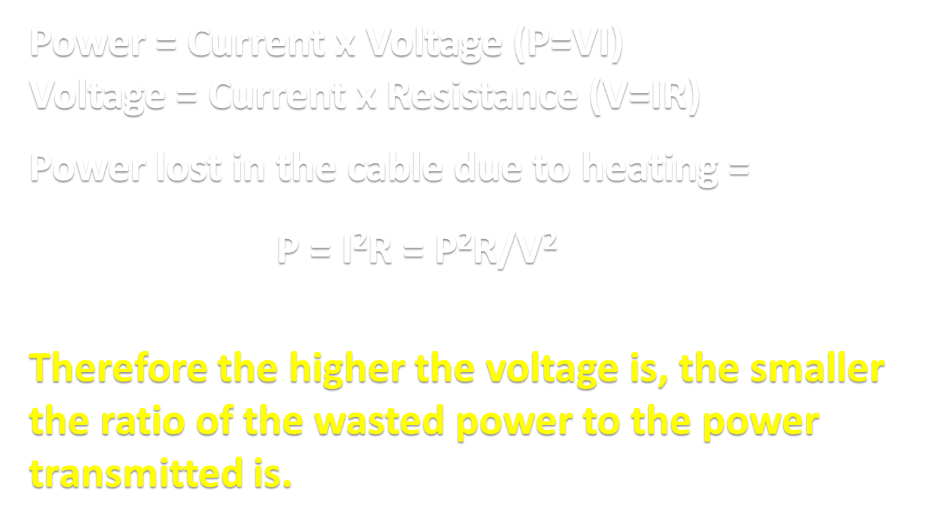

Slide 10

Power = Current x Voltage (P=VI)
Voltage = Current x Resistance (V=IR)
Power lost in the cable due to heating = P = I²R = P²R/V²
For transmission of 1MW of power through cables of resistance of 500Ω at 25kV. The current would be 40A and the power loss would be 0.8MW.
However at 400kV the current required reduces to 2.5A and the power wasted would be about 3.1kW
Notes:
Note - Superconducting cables would be even more efficient but at present, materials that are superconducting at sufficiently high temperature do not exist.

Slide 11

A transformer has a primary coil with 120 turns & a secondary with 2400 turns.
Calculate the required primary voltage to achieve a secondary voltage of 230V [11.5V]
A 230V 60W lamp is connected to the secondary coil.
Calculate the current through
  The secondary coil [0.26A]
  The Primary coil [5.2A]

Slide 12

Explain why the transmission of electrical power over long distances is more efficient at higher rather than lower voltages
A power cable having a resistance of 200Ω is used to deliver 2.0MW of power at 120kV from a power station to an industrial estate.
Calculate :
  The current through the cable [16.7A]
  The power wasted in the cable [56kW]

Slide 13



Conservation of energy (power in = power out).
Faraday's law of induction (changing magnetic field induces an electric current).
Ampere’s law (electric current passing through a wire results in magnetic field around it).
There is magnetic field only if there is a changing electric field i.e. alternating pd.
An electric current only gets induced in a wire when there is a changing magnetic field.

Slide 14
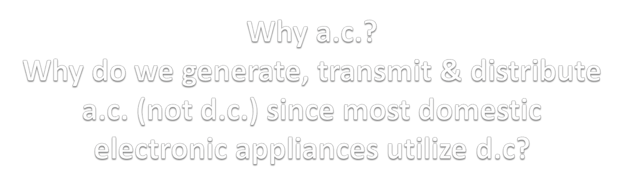
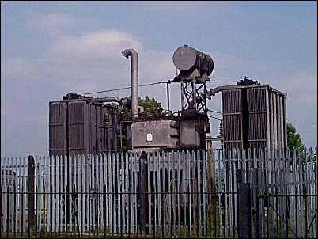

Slide 15

Transformed easily to various voltages
Transmitted efficiently (higher voltage used, implies less energy wasted heating cables)
Power dissipated in the wires =I²R.
So we want to transmit electricity using low I.
Transformers can be used to change the pd of ac.
Power going into transformer = Power going out of transformer (P_{i} = P_{o}) (I_{i}V_{i}=I_{o}V_{o}).

Slide 16

Explain why high voltages are used to transmit electrical power.
Need to appreciate the scientific and economic advantages of alternating current and of high voltages for the transmission of electrical energy
Notes:
High tension power transmission is advantageous from two standpoints – economic and scientific.

Slide 17

The primary reason for high tension (high voltage, low current) power transmission is to reduce the power lost due to the heating effect of the current through the cables during transmission of electricity over significant distance.
- smaller current (in transmission cables)
- smaller heating effect (in transmission cables)
- less energy wasted (in) / more efficient (transmission)

Slide 18

Power generation is the act of converting some energy sources such as solar, wind, water and gas to produce electrical energy.
Electrical power transmission is the act of conveying the generated power from the source of generation in very high voltages over a very long distance as the case may be to the point of distribution.
Distribution is the act of conveying electrical power from transmission end to the end user.
(Efenedo et al., 2012)
GENCOS, DISCOS & TCN: key players in Nigeria

Slide 19

Virtually all of the control of the operations of the power grid are dependent in some manner upon our cyber systems, which encompass the generation, transmission and distribution.
Human resource and customer databases, and information system networks.
A successful malicious physical or cyberattack could lead to outages, failure of operations, damage to key components and equipment, and exposure of confidential customer, employee, or corporate information and cash flows may be adversely affected.
Notes:
Arguably the most critical threat today is a cyber attack on control and communication systems with consequences including service interruptions and electricity load issues that could trigger cascading failures and significant economic damage. Cyber threats pose serious risk to critical national infrastructure, including nuclear facilities.

Slide 20
1. Dr Poulton and Mr Moore
Ranelagh A level Physics Wikispace.
2. Dr John Nunn, Virtual Physics Laboratory.
3. Cambridge International Examinations.
4. Vincent Tago, African Leadership Academy, Johannesburg. South Africa.

